Slide 1
FAA Datasets
Reverse Data Pitch
Ramana Kasibhotla, FAA
May 27, 2015

Slide 2
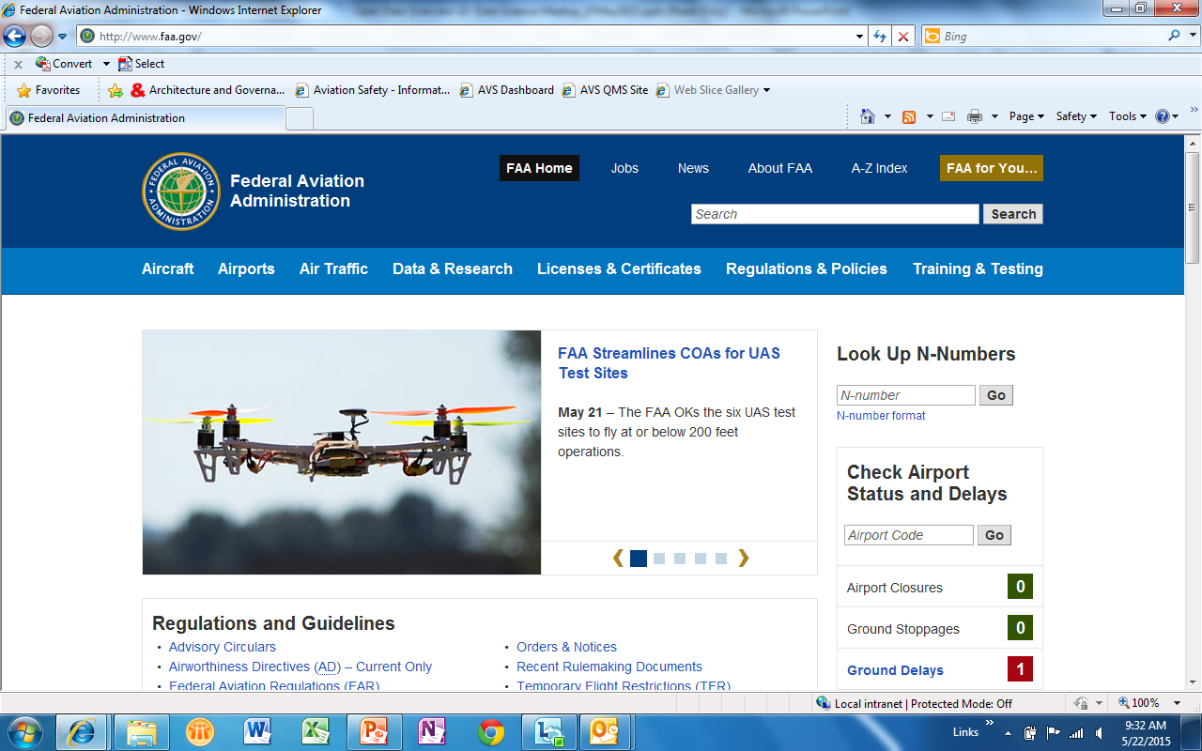
FFAA Website

Slide 3
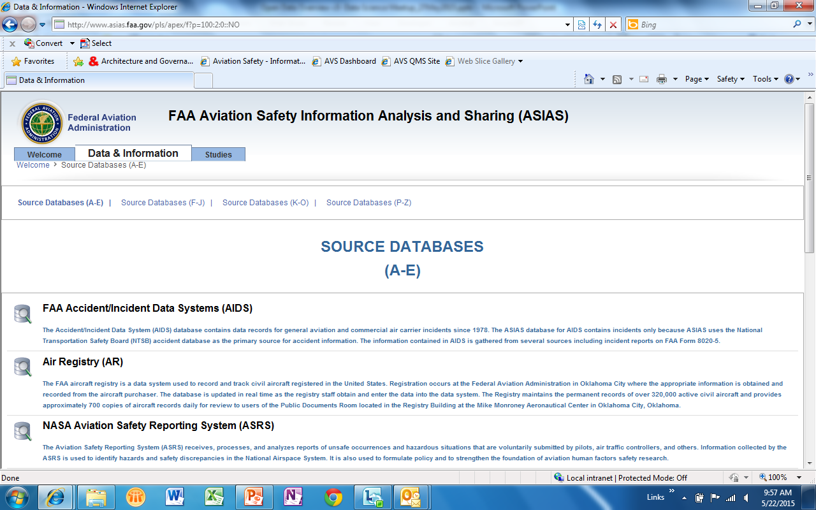
FAA Aviation Safety Analysis System

Slide 4
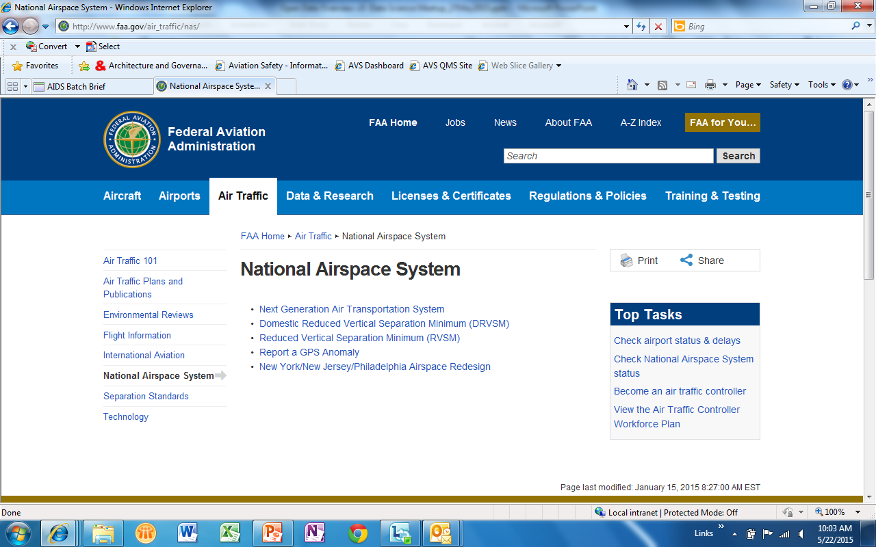
FAA National Airspace System (NAS)

Slide 5
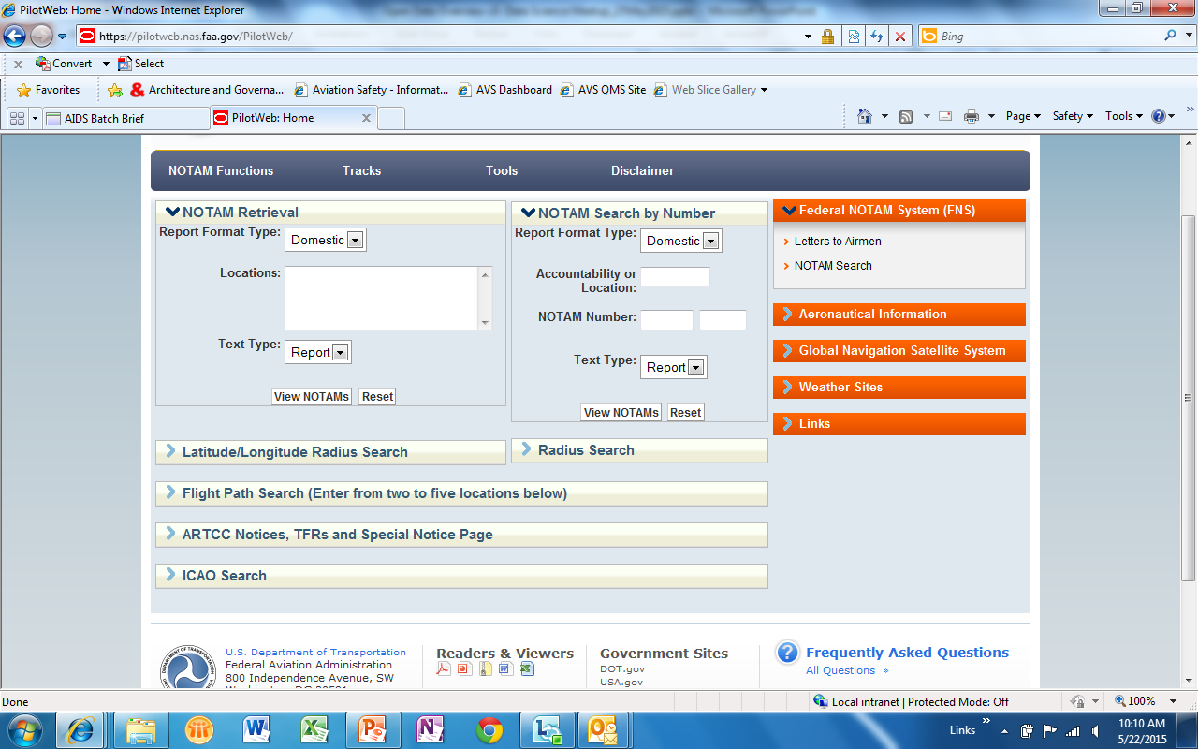
FAA Notice to Airmen (NOTAM) Search Capabilities

Slide 6
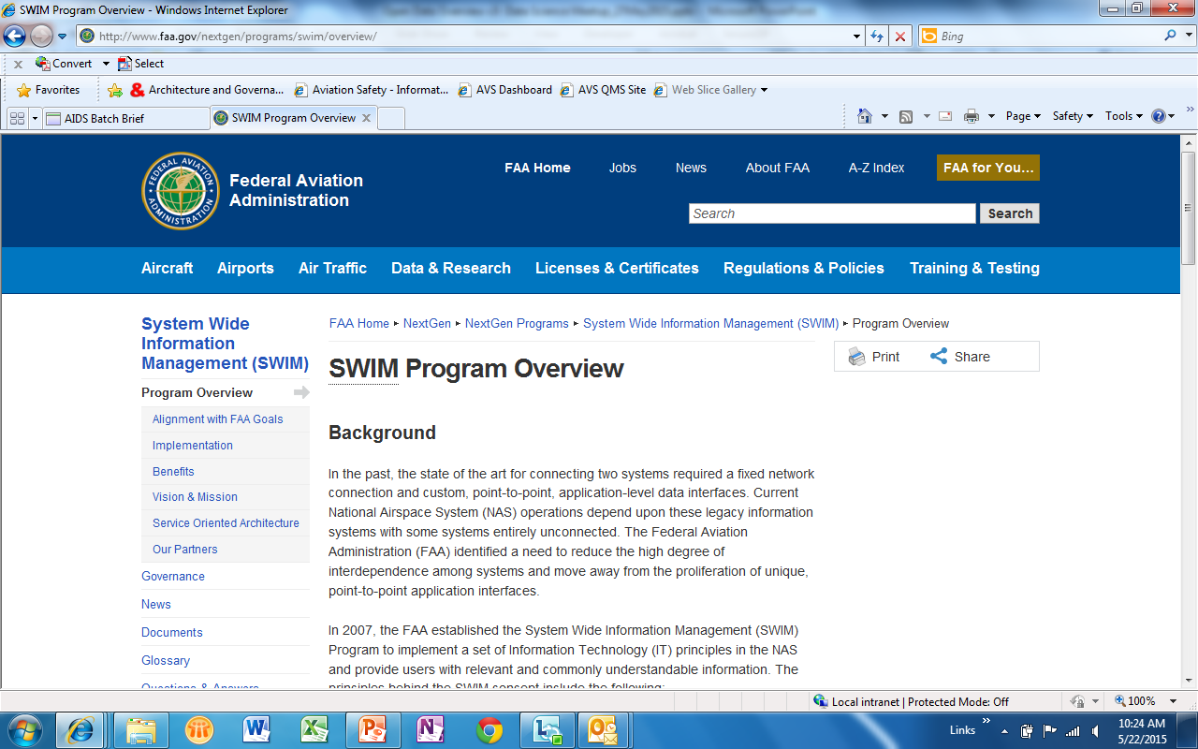
FAA System Wide Information Management (SWIM)

Slide 7
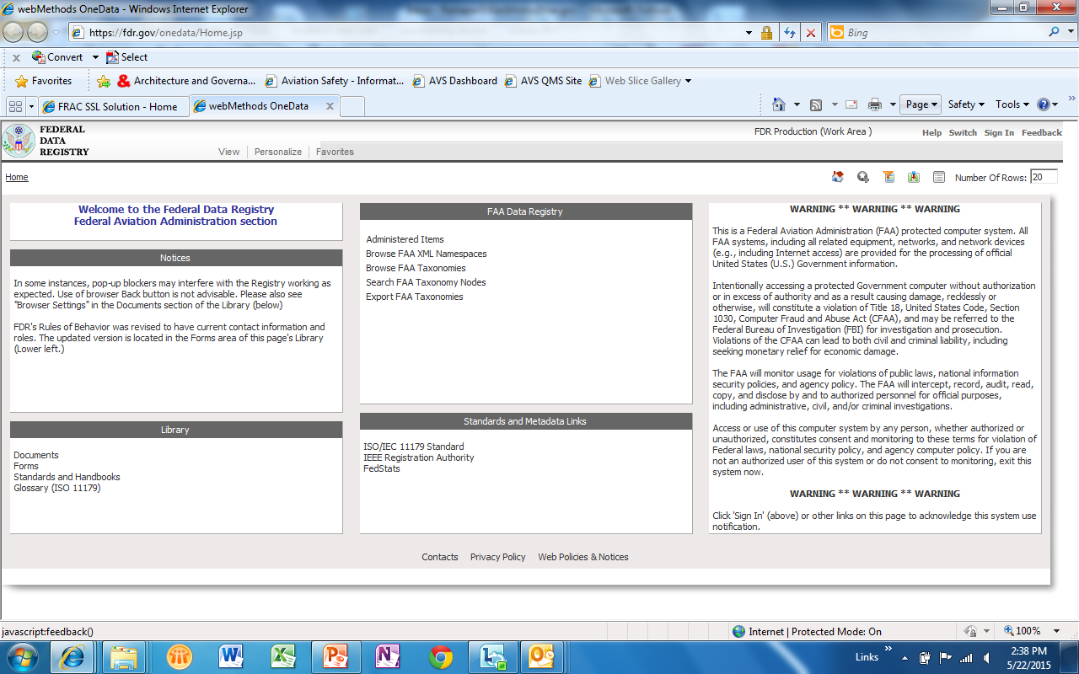
FAA Data Registry (FDR)

Slide 8
Backup Slides

Slide 9
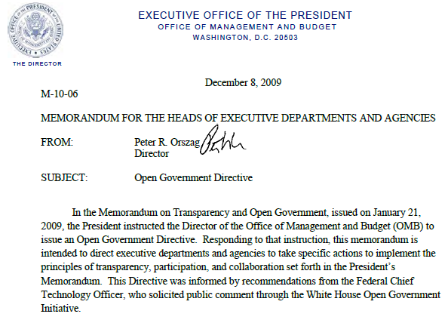

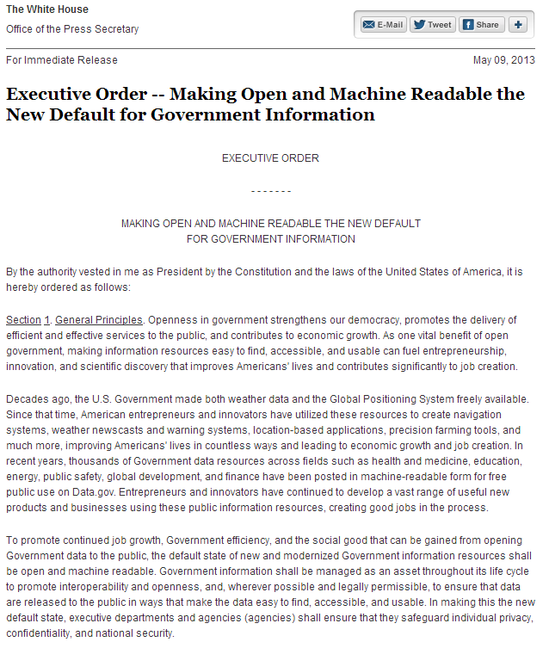
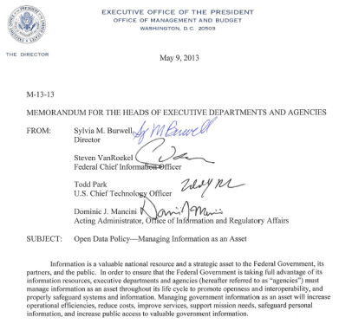
OMB Open Data Mandates
Open Government Policy (M-10-06) 12/2009
Digital Government Strategy 5/2012
Open Data Executive Order 5/2013
Open Data Policy (M-13-13) 5/2013
Cross-Agency Priority Goal 2013
“Publish government information online”
“Make existing high-value data and content available through Web APIs”
“Make open and machine readable the new default for government information”

Slide 10
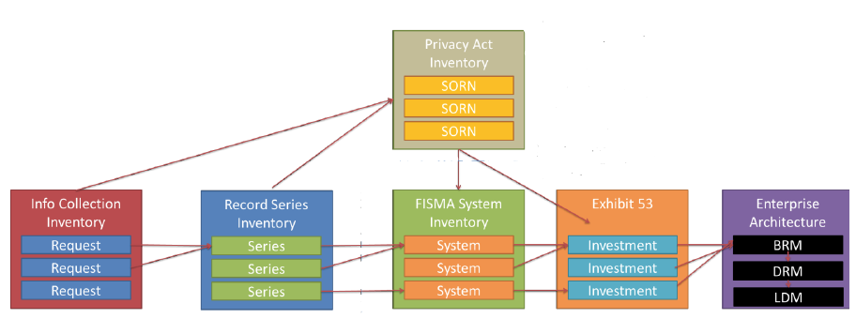
Enterprise Data Inventory Requirement
In accordance with OMB’s Open Data Policy, Executive Order M-13-13 Section III.3.a “Create and maintain an enterprise data inventory” and DOT’s Model Data Inventory Approach “Establishing the Universe,” the FAA will identify datasets or data holdings within the organization and align with the guidance from both OMB and DOT.
The FAA will use two sources of information: the NAS and non-NAS enterprise architectures. These two enterprise architectures contain comprehensive information about FAA NAS systems and Non-NAS applications for which datasets and data holdings are generated.
There are currently 141 NAS Systems and 262 Non-NAS systems within the DOT Metadata Registry.

Slide 11
FAA Open Data Datasets Publication Process

Slide 12
FAA EIM Goals Provides overarching framework to support Open Government & Open Data Initiatives
Manage Data and Information as Assets to Create Business Value
Provide Relevant, Trusted Information in an Actionable Format to Enable Agile Decision-Making
Guide Organizational Culture to Embrace an Information-Centric Enterprise
Open Government Initiative:
Publish Government Information Online
Improve the Quality of Government Information
Create and Institutionalize a Culture of Open Government
Create an Enabling Policy Framework for Open Government
Open Data Initiative:
Strengthen data management and release practices
Collect or create information in a way that supports downstream information processing and dissemination activities
Build information systems to support interoperability and information accessibility
Strengthen measures to ensure that privacy and confidentiality are fully protected and that data are properly secured
Incorporate new interoperability and openness requirements into core agency processes

Slide 13
Common Core and DoT Metadata Fields

Slide 14
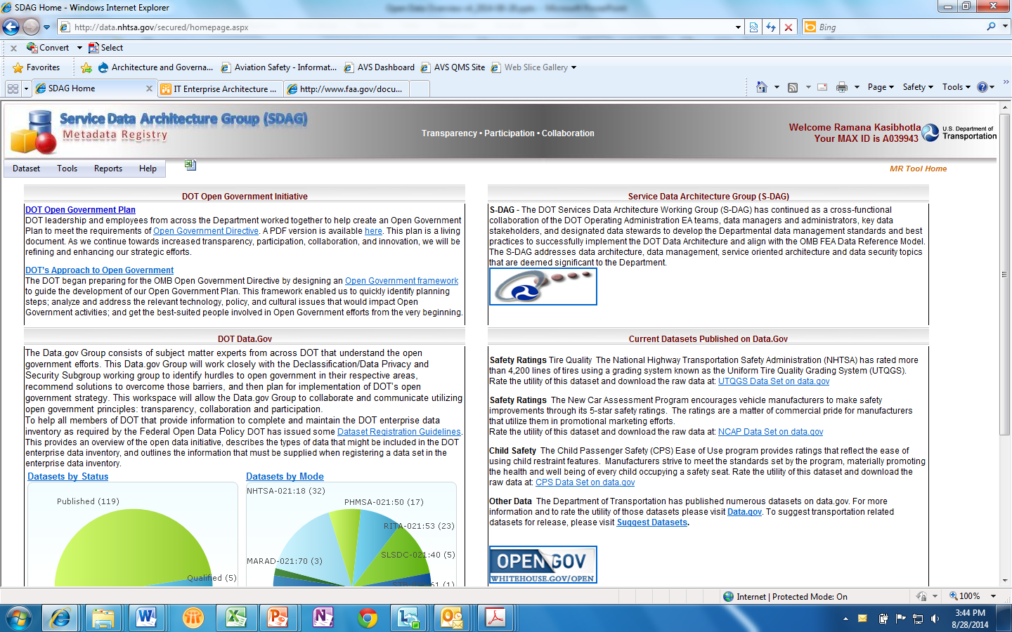
DOT Data Inventory Tool for Open Data Registration

Slide 15
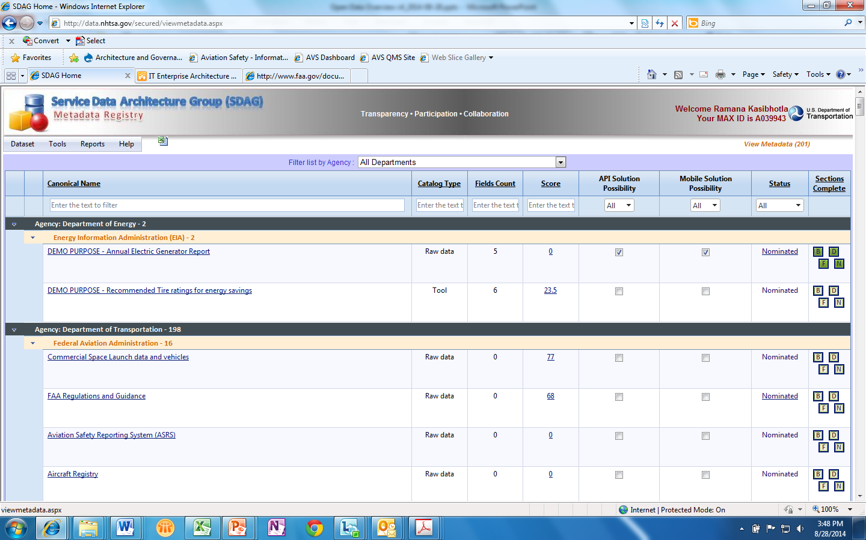
DOT Data Inventory Tool for Open Data Registration

Slide 16
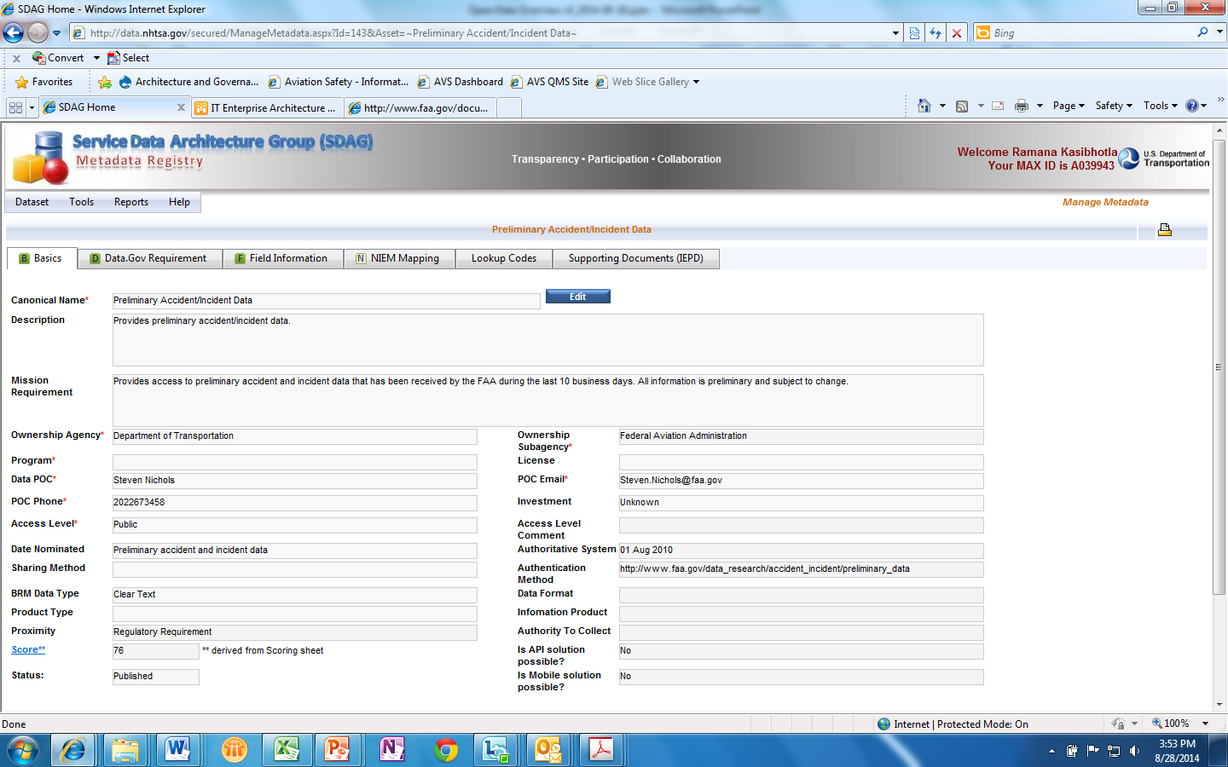
DOT Data Inventory Tool for Open Data Registration

